Slide 1


HEART ATTACK PREDICTION USING
MACHINE LEARNING
GUIDED BY SUBMITTED BY
PRABHJOT SINGH MUKESH SINGH
SUBMISSION DATE SAGAR SOLANKE
02/01/2024 KAJAL VADHER

Slide 2
INTRODUCTION
A heart attack which is analogous to acute myocardial infarction (AMI) is one of the most serious diseases in the segment of cardiovascular disease. It occurs due to the interruption of blood circulation to muscle of the heart which damages the heart the muscle. Diagnosing heart disease is also a crucial task
Machine learning plays a crucial role in the medical field. Using machine learning, we can diagnose, detect, and predict various diseases. Recently, there has been a growing interest in using data mining and machine learning techniques to predict the likelihood of developing certain diseases
This research develops a model that can correctly predict cardiovascular attack to reduce the fatality caused by cardiovascular diseases.

Slide 3
PROBLEM STATEMENT
We are analyzing various machine learning algorithms and finding the best to predict the presence or absence of heart disease.
The target is binary classification which is '0' for absence and '1' for presence of heart disease.

Slide 4
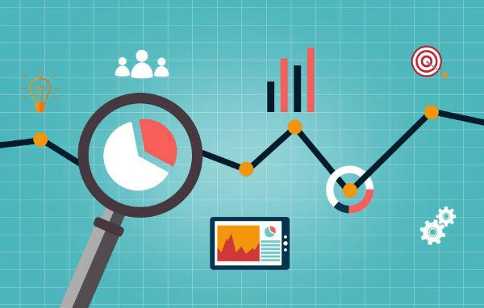
TOOLS AND TECHNOLOGY
A variety of tools and technologies are available for Heat attack prediction data analysis using machine learning.
Programming languages: Python
Libraries: Scikit-learn, Pandas, Numpy
Data visualization tools: Matplotlib, Seaborn
Tools : JupyterLab
Machine learning : Logistics regression, Decision tree, KNN, Naive bayes (Supervised learning).

Slide 5

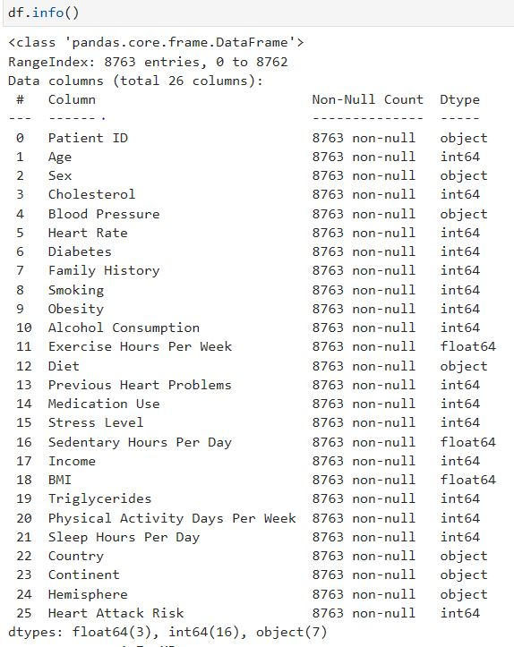
DATA COLLECTION

Slide 6
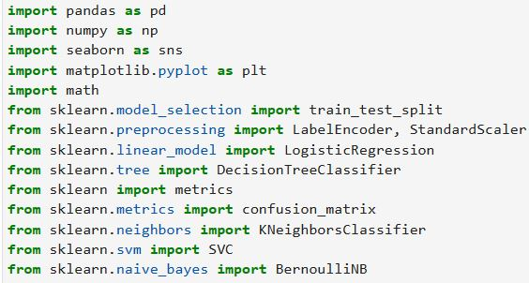
METHODOLOGY USED

Slide 7


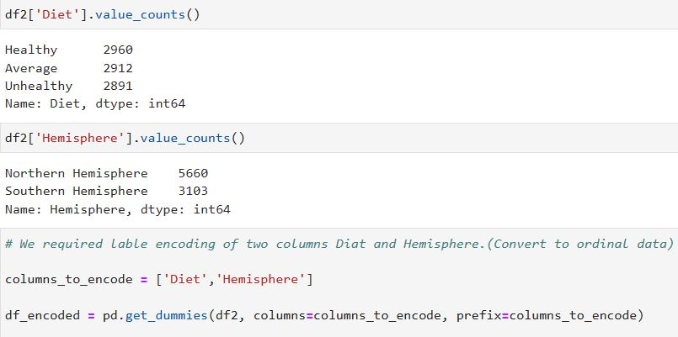
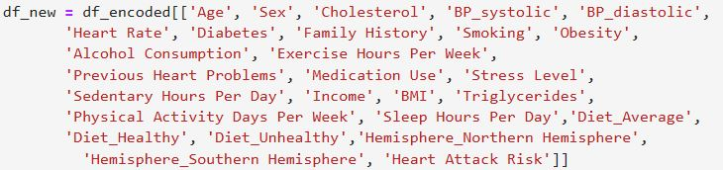
DATA PREPROCESSING
Data preprocessing is essential for improving the quality of input data, making it suitable for model training, and ultimately enhancing the performance and generalization capabilities of machine learning models.

Slide 8

DATA VISUALIZATION
Patient age distribution
Sex wise heart attack risk
Cholesterol range
BP_systolic and BP_diastolic distribution
Diabetes Count
Family history (heart attack risk)
Smoking count
Obesity distribution
Alcohol consumption
Previous heart problem
Stress level
Hemisphere (southern/ northern)
Diet plan

Slide 9

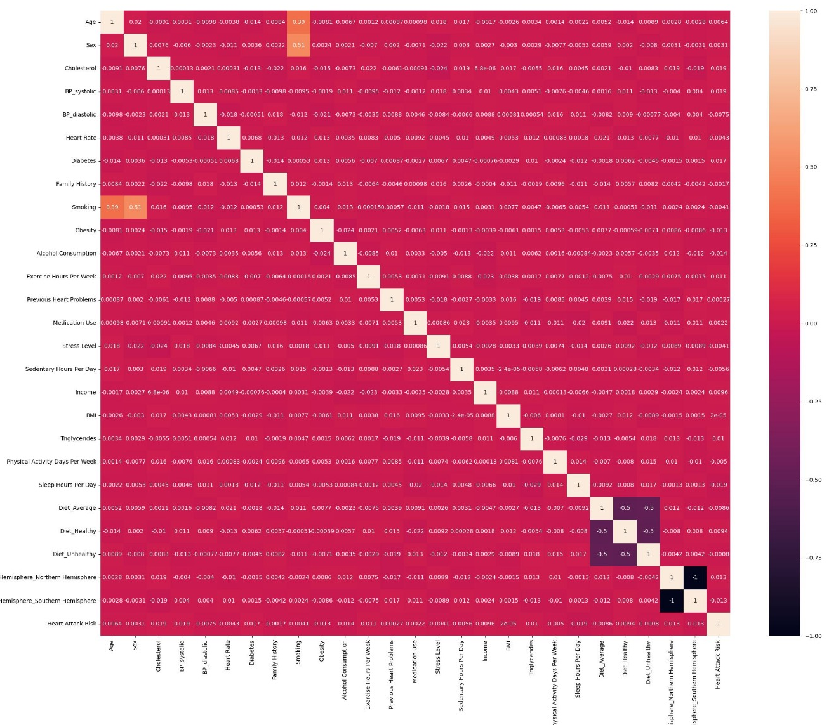
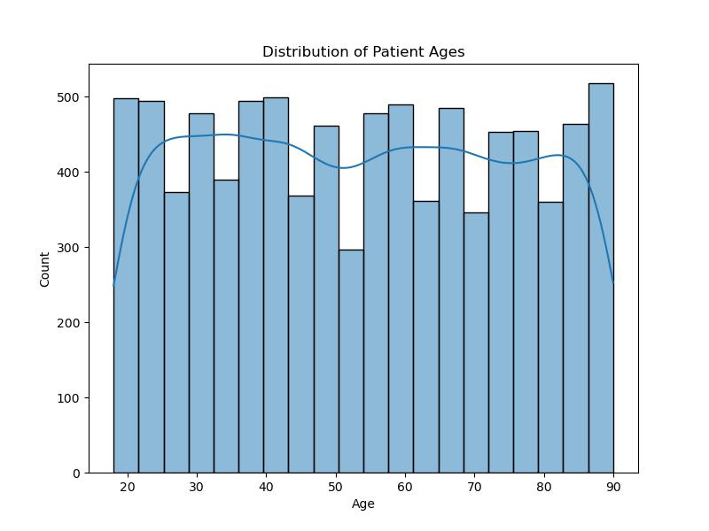
DATA VISUALIZATION / CHARTS

Slide 10
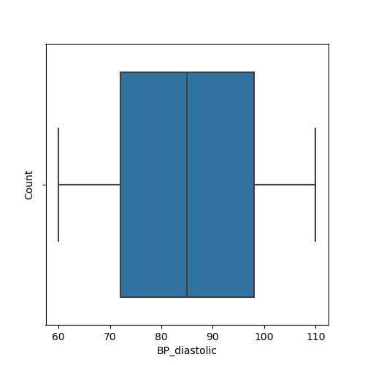
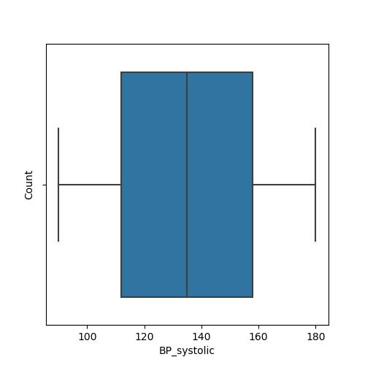
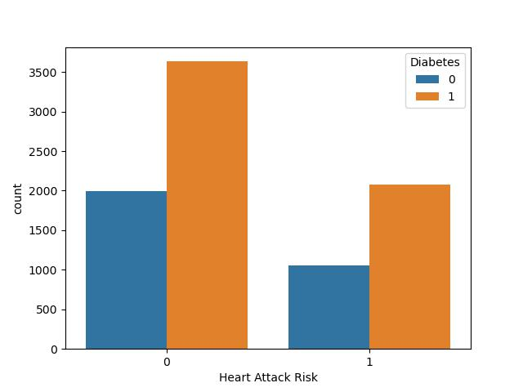
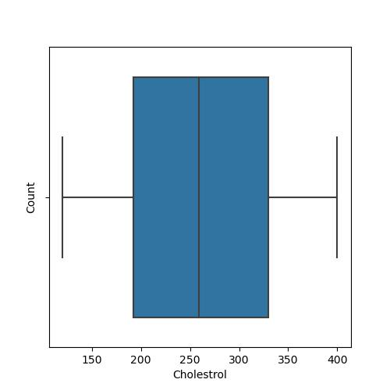
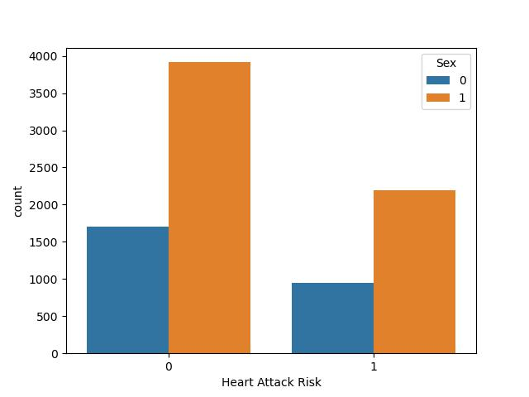
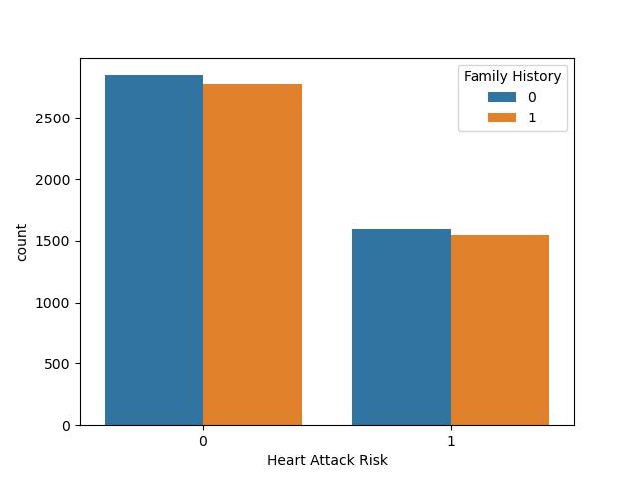
DATA VISUALIZATION/CHARTS

Slide 11
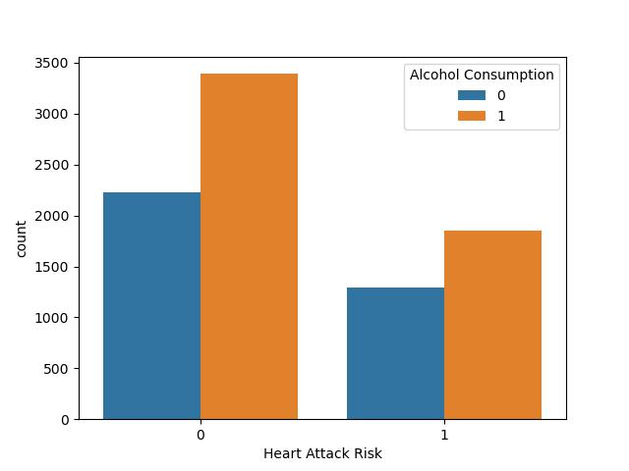
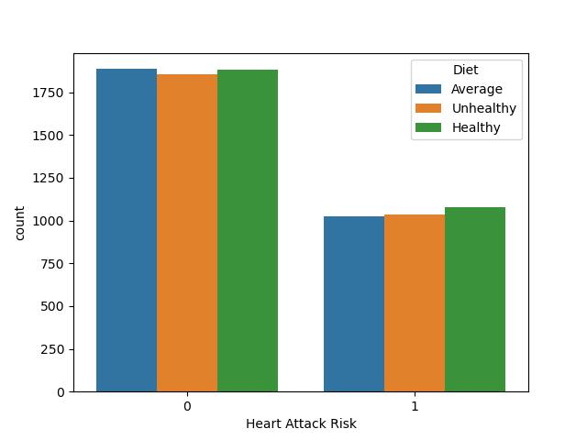
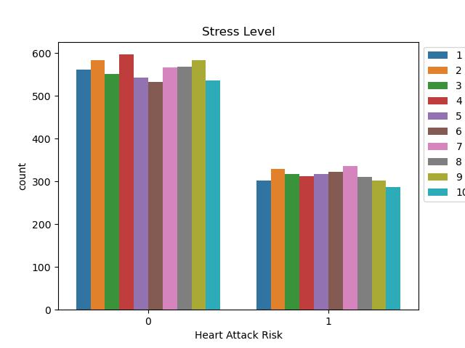
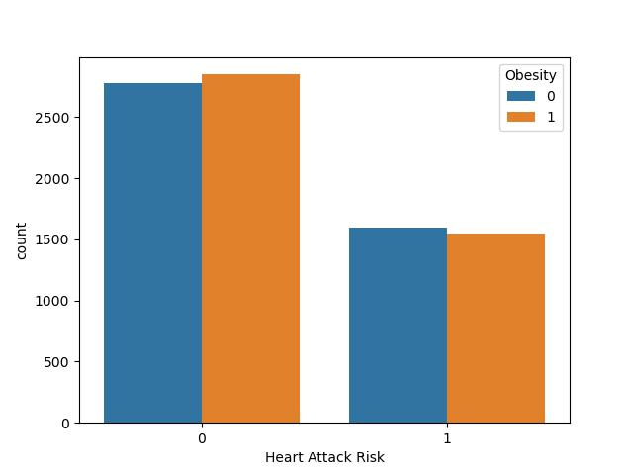
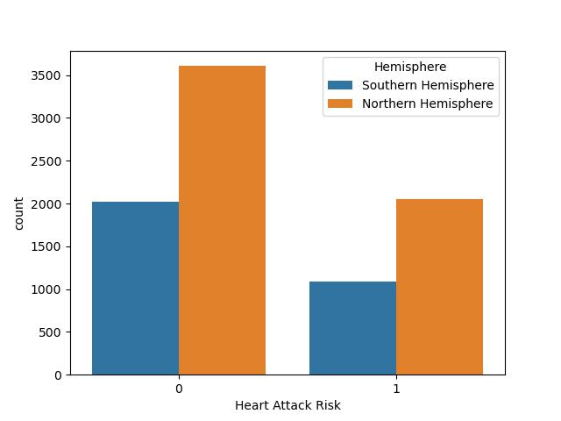
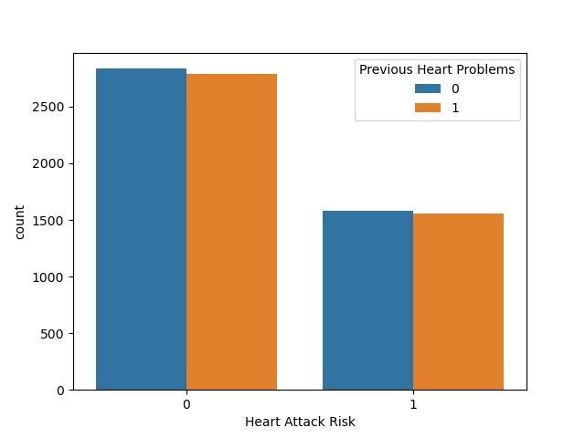

Slide 12
MODELS USED & ACCURACY
MODEL NAME | TRAIN DATA ACCURACY | TEST DATA ACCURACY
LOGISTIC REGRESSION | 64% | 64%
KNN-MODEL | 62% | 61%
DECISION TREE MODEL | 54% | 53%
NAVIE BAYES(BERNOULLINB) | 64% | 65%
O

Slide 13
CONCLUSION
Finally, we can conclude that real-time predictors will be essential in the healthcare sector nowadays. From this project, we will be able to predict real-time heart disease using the patient’s data from the model using the different Algorithm’s, thereby making accurate heart disease prediction using machine learning

Slide 14
REFERENCES
https://www.kaggle.com/code/devendrasingh22/heart-attack-prediction
https://www.geeksforgeeks.org/best-python-libraries-for-machine-learning/

Slide 15

THANK YOU!

